Slide 1
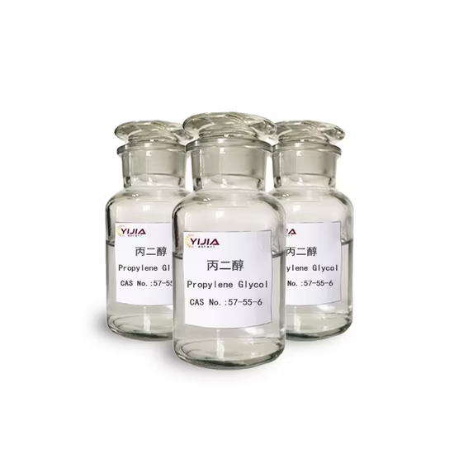
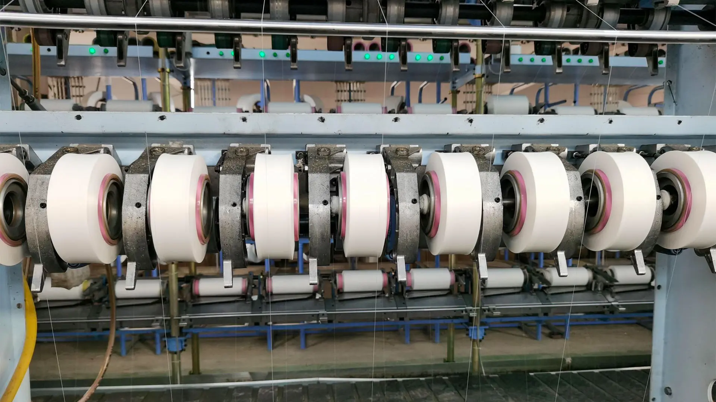
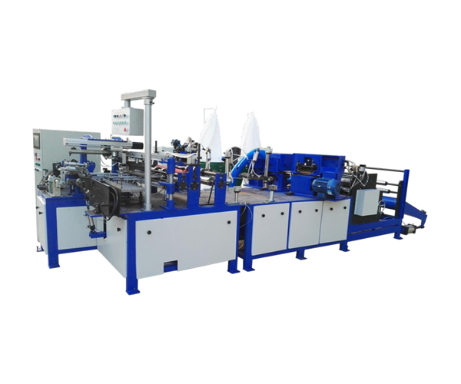
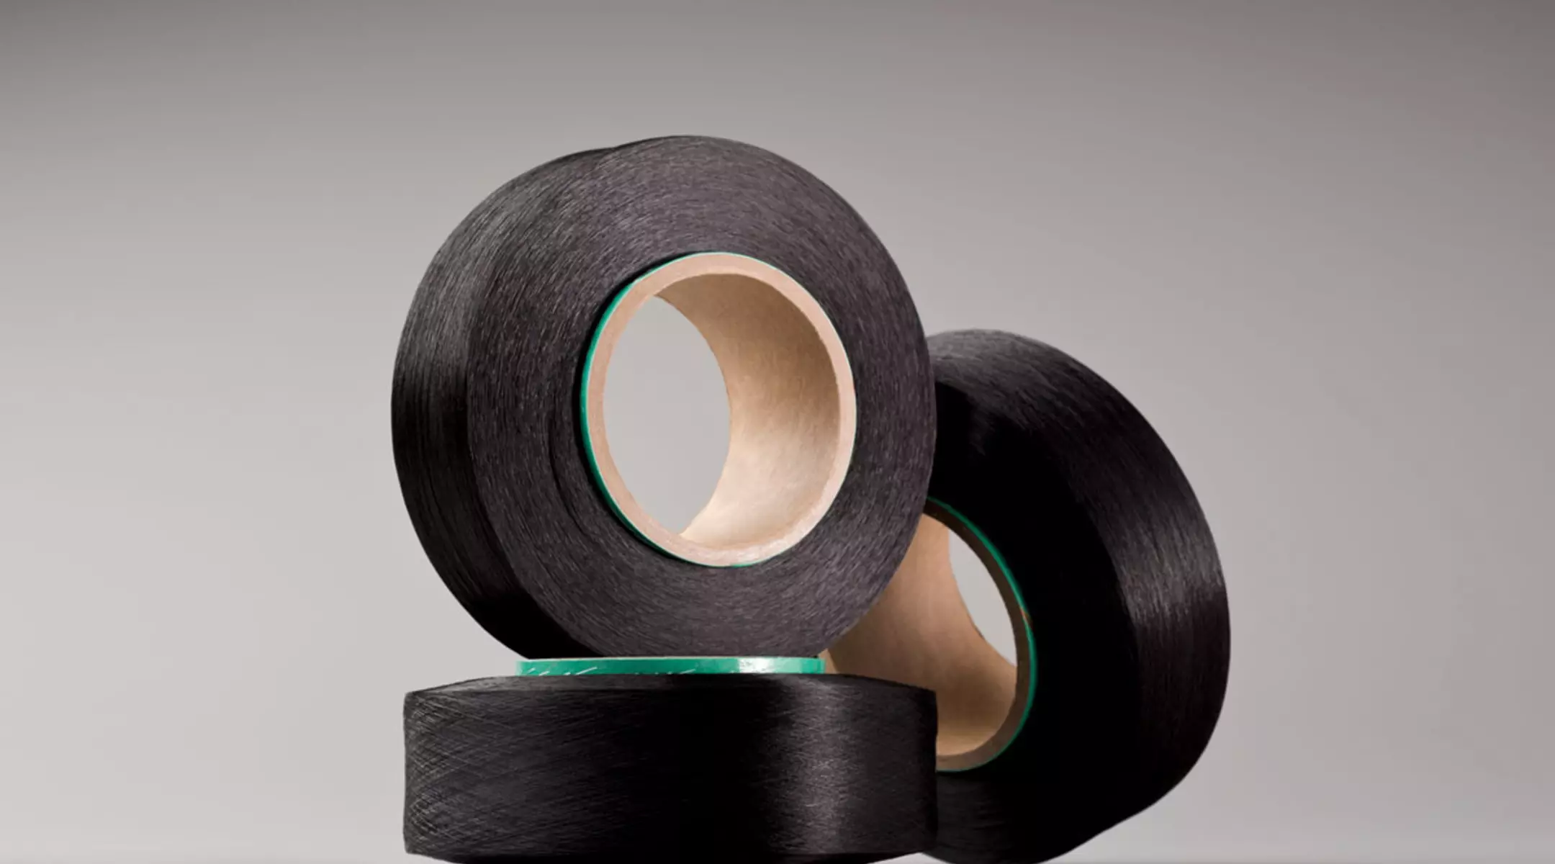
Ministry of Investment,
Industry and Trade of the Republic of Uzbekistan
Production of lycra fiber
Project overview
Business model: manufacturing facility with production capacity of 8 thsd tons of lycra fiber per year
Project scope
Production of lycra fiber
Financing
20 mln USD
Production process for lycra faber
Incentives
Infrastructure development at state cost* (project cost exceeding 15 mln USD)
Across the Republic, 27 FEZs and 4 TIZs offer tax breaks on land, property, water and CIT.
(CIT - applied for investments over 3 mln USD)
Procurement of materials (polyether glycol, diisocyanate and etc.)
Production process
Bonding, winding and cutting
Quality control and packaging:
Project description
Exemption from taxes
3 years if investment is between 0,3 – 3 mln USD
5 years if investment is between 3 – 5 mln USD
7 years if investment is between 5 – 10 mln USD
10 years if investment is over 10 mln USD
Domestic market
Existing 5 neighbor markets
Russia, Europe, Middle East markets
7 production lines
Products: - special medical clothing
- medical masks
- special bags
~300 employees
Production and trade volume of synthetic fiber (2024)
Infrastructure
Gas 12 cents/m³
Electricity 7 cents/kWh
Water 20 cents/m³
Import
Consumption
Consumption (CA)
23 thsd tons
26 thsd tons
130 thsd tons

Slide 2
Ministry of Investment,
Industry and Trade of the Republic of Uzbekistan
We invite to invest in textile production in Uzbekistan
Project overview
Trade agreements
Competition: Uzbekistan offers highly competitive structure of operating costs for manufacturing of woven fabric internationally
GSP+ agreement allows to export to EU at reduced or zero tariff for 6 200 products.
CIS Free Trade Agreement creates more integrated and open market with CIS countries.
Top-7 woven fabric exporters, USD bln
Woven fabric import to Uzbekistan, USD mln
Average wage, USD ths per month
Average electricity cost,
US cents per kWh
China | 3,8 | 16,4 | 1,3 | 12
Germany | 2 | 2 | 3,5 | 25
USA | 1,9 |  | 4,5 | 10
Italy | 1,3 | 0,1 | 2,4 | 20
Japan | 0,9 |  | 3 | 20
Turkey | 0,7 | 12,6 | 0,7 | 13
France | 0,5 |  | 3 | 12
 | 0,005 |  | 0,4 | 7
Location
Andijan region
Andijan region
Size | 4 200 km²
Population | 2,9 million
Uzbekistan
Availability of labor in textile industry
Local textile products manufacturers can benefit from:
- Stable economical and political situation
- Availability of skilled & unskilled labor
- Building on existing infrastructure and distribution networks
- Infrastructure development at state cost*
- Incentives: Free economic zones offer tax breaks on land, CIT, water.
Higher education institutions: 2
Faculties of higher education: 12
Number of graduates: 2 000

