Slide 1


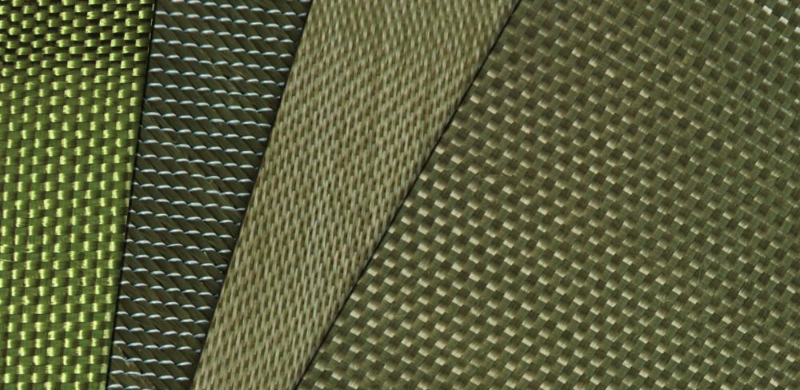
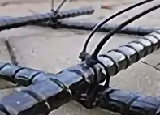







Production of Basalt Fiber Products
Industry
Project Indicators
Construction Materials and Textiles
Project goal
Cost of the project :
Investment Requirement:
$ 20 million
$ 17,5 million
Production of fabrics, rebar, pipes, and other products made from basalt fiber.
Capacity:
Local market – 50%
Export – 50%
30 thousand tons (per year)
Advantages of the Innovative Material
Growing demand for sustainable and eco-friendly materials.
Basalt fibers are derived from natural volcanic rock, making them a viable alternative to synthetic fibers.
Performance advantages.
High tensile strength, thermal stability, and corrosion resistance make basalt fibers suitable for a wide range of applications.
Technological advancements in production.
improved manufacturing methods enhance the economic efficiency, consistency, and quality of basalt fiber, making it more accessible for industrial use.
Cost-effectiveness.
Compared to carbon fibers, basalt fibers offer similar benefits at a lower cost, making them an attractive option for industry.
Payback:
Up to 5 years
~100 employees
Technological Process
Fiber Production
Strand Formation
Production of Pipes and Rebar
Production of Fabrics and Braids
Project Initiator
Administration of Altinsay District, Surkhandarya Region
Altinsay District, No. 8 Str. Mustaqillik,
altynsay@sdv.uz
https://oltinsoy.uz
Location
Surkhandarya region
Market
According to Verified Market Reports, the basalt fiber market was valued at 200 million USD in 2024.
.According to a study by Future Market Report, the global basalt fiber market is estimated at 370,1 million USD in 2024. It is expected to reach 679,9 million USD by the end of 2032, with a compound annual growth rate (CAGR) of 12,3% during the period from 2024 to 2032.
The basalt fiber market is projected to reach 500 million USD by 2033, with a CAGR of 10,5% from 2026 to 2033.
Surkhandarya region
Size | 20 800 km²
Population | ~2,9 million
Required area
~ 3,5 ha

Slide 2


International logistics transport corridors
Tallin
Sankt-Peterburg
Riga
Latvia
Moscow
Klaipeda
Hamburg
Minsk
Berlin
Brest
Povorina
Essen
Lviv
Kyiv
Paris
Chop
Volgograd
Kandiagash
Aktogay
Astraxan
Beyney
Saksaulskaya
Ulan-Bator
Osh
Bayangal-Mangal
Mersin
Malatya
Saraxa
Mazar-i-Sharif
Kashgar
Xirat
Afghanistan
Peshavar
Iran
Pakistan
Bandar-e-Abbas
Chakhbahar
Karachi

Slide 3

Air connections from Tashkent and other airports of Uzbekistan
New York
A visa-free policy for tourists from
90 countries
Diverse range of 59 carriers in Uzbekistan’s airport
11 airports across the Country, the main airports are Tashkent, Samarkand and Bukhara

