Slide 1
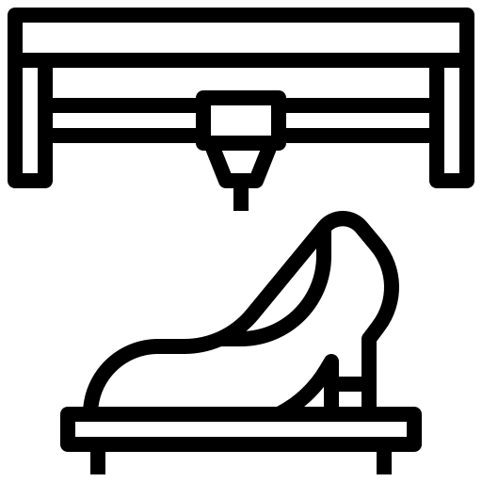
Ministry of Investment,
Industry and Trade of the Republic of Uzbekistan
Production of leather shoes
Project overview
Business model: manufacturing facility with production capacity of 1 mln pairs of leather shoes per year
Project scope
Production of leather shoes
Financing
10 mln USD
Production process for leather shoes
Incentives
Infrastructure development at state cost* (project cost exceeding 15 mln USD)
Across the Republic, 27 FEZs offer tax breaks on land, property, water and CIT.
(CIT - applied for investments over 3 mln USD)
Procurement
of materials (high quality leather and other materials)
Leather preparation, design and pattern making
Cutting, stitching and shoe assembly
Quality control and packaging:
Project description
Domestic market
Existing 5 neighbor markets
Russia, Europe, Middle East markets
5 production lines
Exemption from taxes
3 years if investment is between 0,3 – 3 mln USD
5 years if investment is between 3 – 5 mln USD
7 years if investment is between 5 – 10 mln USD
10 years if investment is over 10 mln USD
Capability to produce various types, sizes and design
~300 employees
Production and trade volume of leather shoes (2023)
Production
Export
Import
Consumption
Consumption (CA)
Infrastructure
Gas 12 cents/m³
Electricity 7 cents/kWh
Water 20 cents/m³
306 mln
pairs
25 mln pairs (32 mln doll)
6 mln pairs (26 mln doll)
287 mln
pairs
543 mln
pairs

Slide 2
Ministry of Investment,
Industry and Trade of the Republic of Uzbekistan
We invite to invest in leather production in Uzbekistan
Project overview
Trade agreements
Competition: Uzbekistan offers highly competitive structure of operating costs for manufacturing of leather shoes internationally
GSP+ agreement allows to export to EU at reduced or zero tariff for 6 200 products.
CIS Free Trade Agreement creates more integrated and open market with CIS countries.
Top-7 leather shoes exporters, USD bln
Leather shoes import to Uzbekistan, USD mln
Average wage, USD ths per month
Average electricity cost,
US cents per kWh
China | 53,3 | 10,8 | 1,3 | 12
Vietnam | 31,1 | 2,5 | 0,3 | 10
Italy | 14,5 | 2,5 | 2,4 | 20
Germany | 10,9 | 0,055 | 3,5 | 25
Belgium | 8,4 |  | 3,5 | 17
Indonesia | 6,4 | 0,9 | 1,2 | 12
France | 6 |  | 3 | 12
 | 0,032 |  | 0,4 | 7
Location
Andijan region
Andijan region
Size | 4 200 km²
Population | 2,9 million
Uzbekistan
Availability of labor in leather industry
Local leather products manufacturers can benefit from:
- Stable economical and political situation
- Availability of skilled & unskilled labor
- Building on existing infrastructure and distribution networks
- Infrastructure development at state cost*
- Incentives: Free economic zones offer tax breaks on land, CIT, water.
Higher education institutions: 5
Faculties of higher education: 12
Number of graduates: 1 100

Slide 3
On the strategic international logistics corridor
Ministry of Investment,
Industry and Trade of the Republic of Uzbekistan
Tallin
Sankt-Peterburg
Riga
Latvia
Moscow
Klaipeda
Hamburg
Minsk
Berlin
Brest
Povorina
Essen
Lviv
Kyiv
Paris
Chop
Volgograd
Kandiagash
Aktogay
Astraxan
Beyney
Saksaulskaya
Ulan-Bator
Osh
Bayangal-Mangal
Mersin
Malatya
Saraxa
Mazar-i-Sharif
Kashgar
Xirat
Afghanistan
Peshavar
Iran
Pakistan
Bandar-e-Abbas
Chakhbahar
Karachi

Slide 4
Excellent air connectivity from Tashkent and other Uzbek airports
Ministry of Investment,
Industry and Trade of the Republic of Uzbekistan
New York
A visa-free policy for tourists from 90 countries
Diverse range of 59 carriers in Uzbekistan’s airport
11 airports across the Country, the main airports are Tashkent, Samarkand and Bukhara

