Slide 1

Ministry of Investment,
Industry and Trade
of the Republic of Uzbekistan
Privatization of Privatization of LLC “SQB Construction”
Project overview
Business model:
Full ownership transfer via public auction. The enterprise operates in Tashkent, developing commercial and residential properties.
Project scope
Privatization of 100% shares of LLC “SQB Construction”, a subsidiary of JSCB "Uzpromstroybank", specializing
in construction and real estate development
Investment terms:
Investor will acquire 100% ownership via public auction.
Timeline
2025
2026
Transfer of ownership to the investor
Auction preparation and public bidding
Financing (estimated value)
$8-12 million (subject to auction results)
Location
Shayxontohur district, Tashkent city
Advantages and Potential
Strategic location in Uzbekistan’s economic hub.
High demand for commercial and residential properties.
Potential for large-scale development projects.

Slide 2

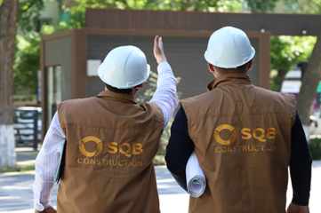
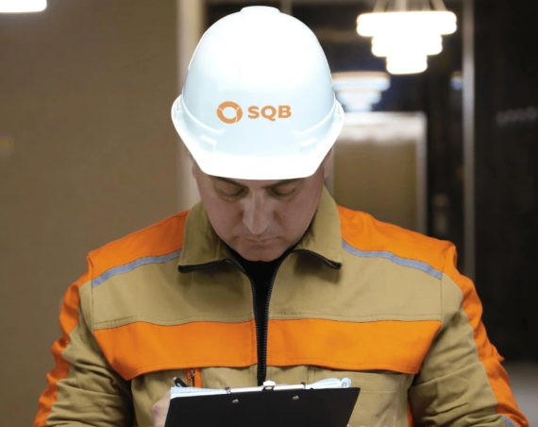

We invite to invest in Privatization of LLC “SQB Construction”
Ministry of Investment,
Industry and Trade
of the Republic of Uzbekistan
Project overview
Location
Tashkent city
Population | 3,0 million
Tashkent region
Area | 435 km²
Construction Sector Growth | 7%
Tashkent city
Competitive landscape
Booming construction sector in Tashkent with high demand for real estate.
The project will capture 5-10% of Tashkent’s construction market by 2027.
NPV
$1.8 million
IRR
16.5%
PI
1.22
PP
4.6 years

